Slide 1



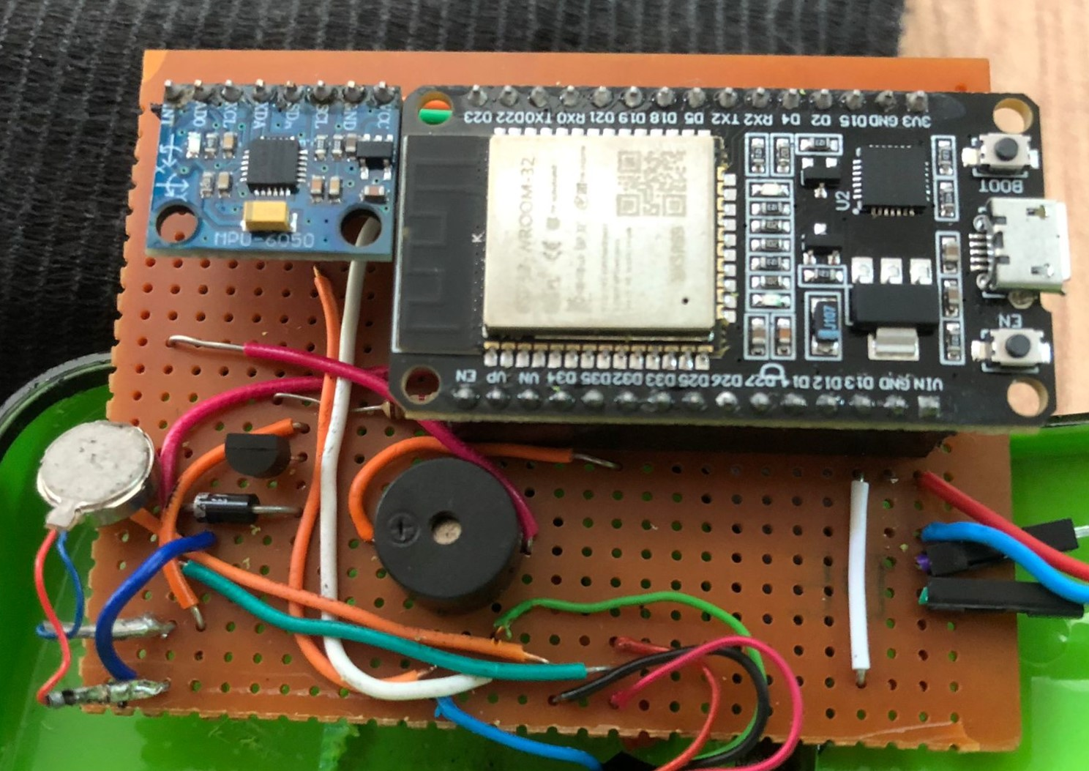
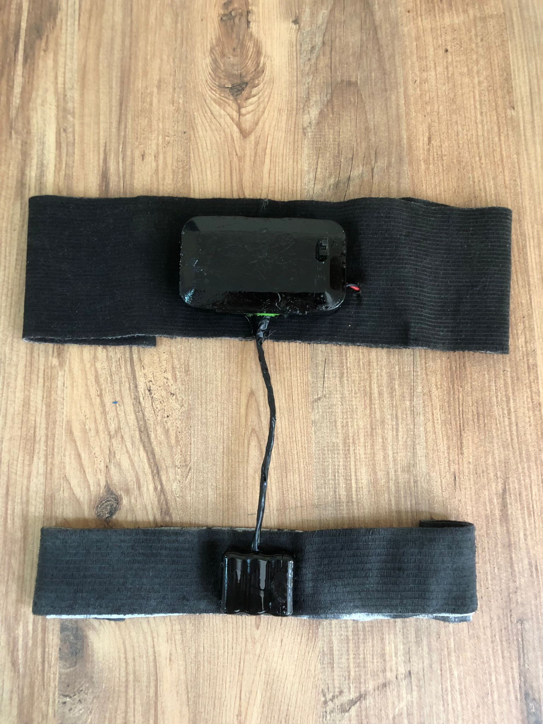
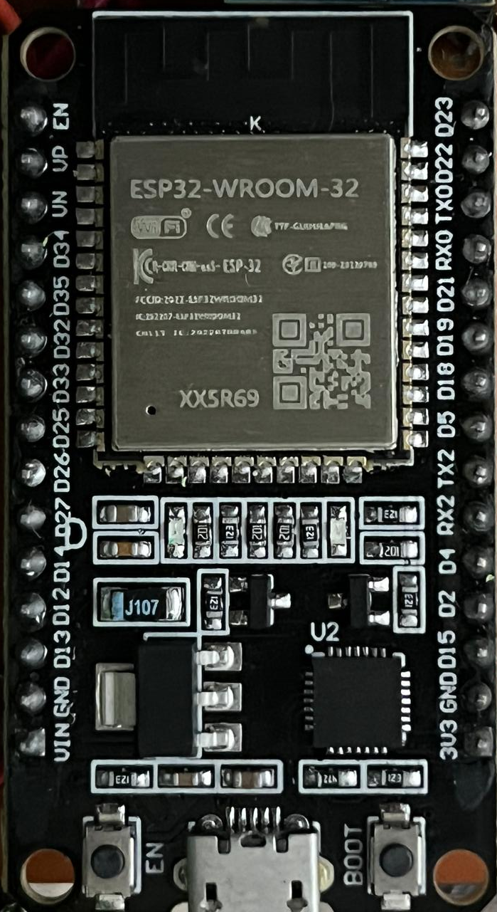
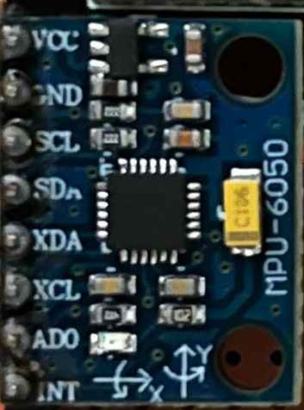
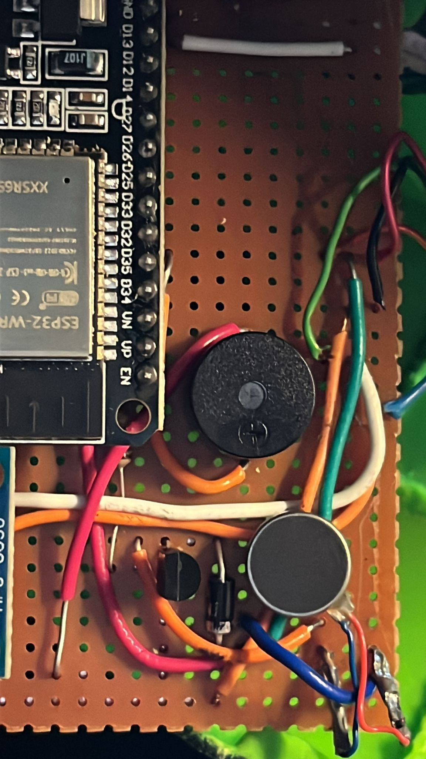
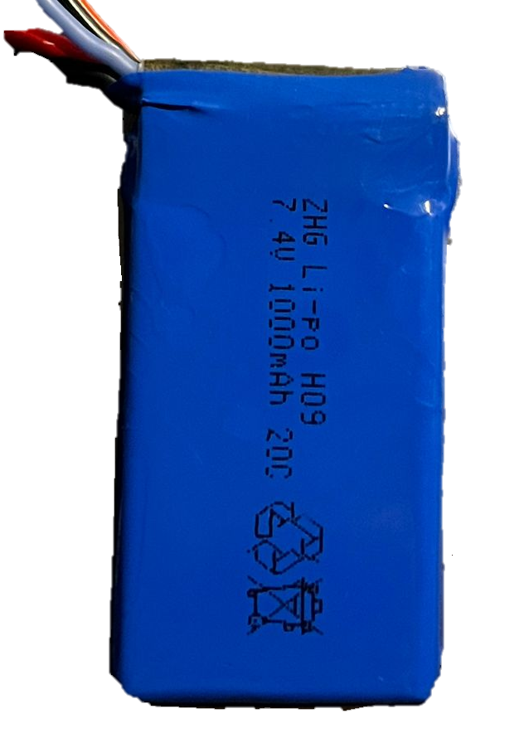
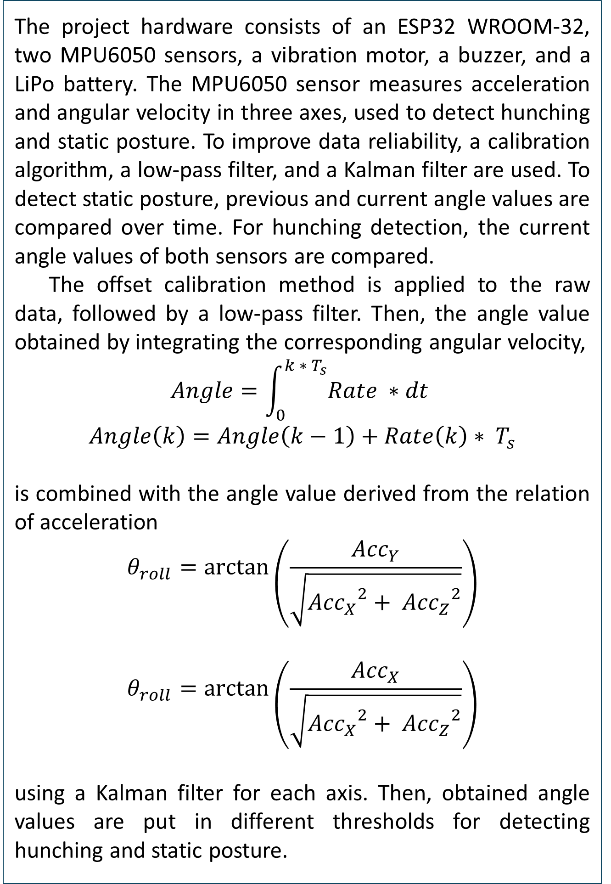
Keep Moving
İlayda Öğütverici, 270206022 - Batuhan Gözaçan, 250206007 –
Samed Kaan Akçam, 270206011
CENG 424 Embedded Computer Systems
Supervisor: Berat Alper Erol, PhD
Abstract
Methodology and Tools
Back pain significantly impacts productivity and quality of life. To address this, we are developing a wearable device using an ESP32 microcontroller and two MPU6050 sensors to monitor posture and provide alerts. The project hardware calculates angles to detect hunching and static posture. Initially focused on notifying users of non-ideal posture, our research indicates that prolonged static posture is more closely correlated with back pain. Therefore, our project now aims to alert the user when they are static for a long time, but there is an option for hunching alert enabling too.
The project hardware consists of an ESP32 WROOM-32, two MPU6050 sensors, a vibration motor, a buzzer, and a LiPo battery. The MPU6050 sensor measures acceleration and angular velocity in three axes, used to detect hunching and static posture. To improve data reliability, a calibration algorithm, a low-pass filter, and a Kalman filter are used. To detect static posture, previous and current angle values are compared over time. For hunching detection, the current angle values of both sensors are compared.
The offset calibration method is applied to the raw data, followed by a low-pass filter. Then, the angle value obtained by integrating the corresponding angular velocity,
$$Angle=\int_{0}^{k ∗ T_{s}}{Rate ∗dt}$$
$$Angle\left(k\right)=Angle\left(k−1\right)+Rate\left(k\right)∗ T_{s}$$
is combined with the angle value derived from the relation of acceleration
$$θ_{roll}=arctan⁡\left(\frac{{Acc}_{Y}}{\sqrt{{{Acc}_{X}}^{2}+ {{Acc}_{Z}}^{2}}}\right)$$
$$θ_{roll}=arctan⁡\left(\frac{{Acc}_{X}}{\sqrt{{{Acc}_{X}}^{2}+ {{Acc}_{Z}}^{2}}}\right)$$
using a Kalman filter for each axis. Then, obtained angle values are put in different thresholds for detecting hunching and static posture.
Introduction
Figure 6: Circuit
Back pain affects nearly everyone globally, with around 20% experiencing it annually and up to 50% at least once in their lifetime (Ehrlich, 2003). Contrary to popular belief, there is no strong evidence linking poor posture to pain. Pain can lead to poor posture, but not vice versa (Kripa & Kaur, 2021). Studies show that individuals with chronic back pain tend to sit statically compared to pain-free individuals (Bontrup et al., 2019). Therefore, encouraging postural changes is safer than maintaining an "ideal" posture.This project aims to promote healthier postural habits without enforcing a strict posture. Our objective is to alert users when a specific posture is held for too long, using haptic feedback and sound notifications to remind them to stretch and change position. This approach is less invasive and more suitable for those with back pain, who adapt to pain-free positions based on personal experience (Bontrup et al., 2019). There is an option for changing the mode to hunching alert for the users who are more interested in sitting upright.
Results
The development and initial testing of our wearable posture monitoring device have shown promising results. The offset calibration method and low-pass filter effectively enhanced data accuracy and reduced noise. The Kalman filter provided precise posture detection by combining angle values from angular velocity and accelerometer data. The device accurately detected static postures and changes, including hunching and tilting, and the haptic feedback and sound notification systems effectively alerted users to prolonged static postures, prompting timely adjustments. The option in the mobile app to change the mode to hunching alert enables users who are more interested in sitting upright to use the device. The mobile app also enables the user to turn on/off vibration and sound depending on the environment that they are in. The device was comfortable for prolonged use and did not interfere with daily activities. These results highlight the device's effectiveness in promoting healthier postural habits and its potential for back pain management. Future iterations will refine detection algorithms and enhance the user interface based on further user testing and feedback.
Figure 7: Final Product
References
Fedorov, D. S., Ivoilov, A. Y., Zhmud, V. A., & Trubin, V. G. (2015). Using of measuring system MPU6050 for the determination of the angular velocities and linear accelerations. Automatics & Software Enginery, 11(1), 75-80.
Gilda, S., & Slepian, Z. (2019). Automatic Kalman-filter-based wavelet shrinkage denoising of 1D stellar spectra. Monthly Notices of the Royal Astronomical Society, 490(4), 5249-5269.
Albaghdadi, A., & Ali, A. (2019). An optimized complementary filter for an inertial measurement unit contain MPU6050 sensor. Iraqi Journal for Electrical and Electronic Engineering, 15(2), 71-77.
Figure 2: MPU6050 Accelerometer and Gyroscope Sensor
Figure 1: Microcontroller Unit ESP32 WROOM
Figure 4: Vibration Motor
Discussion
Our wearable posture monitoring device shows significant potential for improving user well-being by addressing back pain through enhanced postural awareness. To ensure data reliability, we applied offset calibration, a low-pass filter, and a Kalman filter, resulting in highly accurate posture detection. We focused on alerting users to prolonged static postures, aligning with research linking these postures to back pain. This strategy allows users to make natural adjustments based on their comfort. Future work will refine detection algorithms and improve the app interface based on user feedback.
Acknowledgement
Figure 3: 7.4V 1000 maH LiPo Battery
We would like to express our sincere gratitude to Dr. Erol for his invaluable guidance and support throughout our work. Furthermore, we extend our heartfelt appreciation for Dr. Erol's financial assistance, which significantly alleviated the burden of our expenses and allowed us to focus wholeheartedly on our project.
Figure 5: Buzzer
Spring 2024
CENG 424 Embedded Computer Systems
Supervisor: Berat Alper Erol, PhD

